Slide 2

D.A.M Design Subsystem
Quang Nguyen| 29/05

Slide 3

Agenda
Mind map
Use-case
UI/UX OF DAM Subsystem
Database design
Q&A

Slide 4
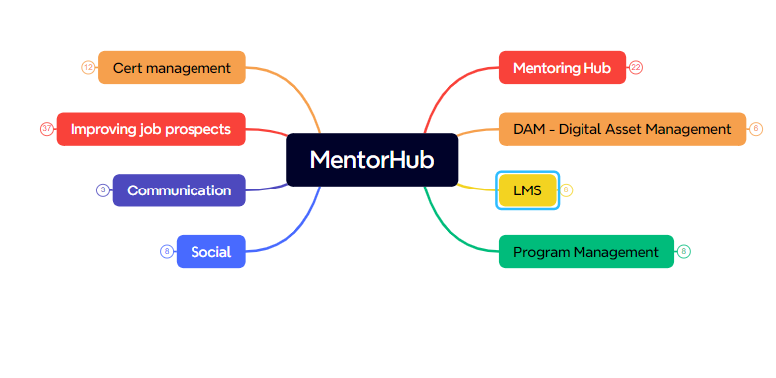
Mind map
MentorHub

Slide 5
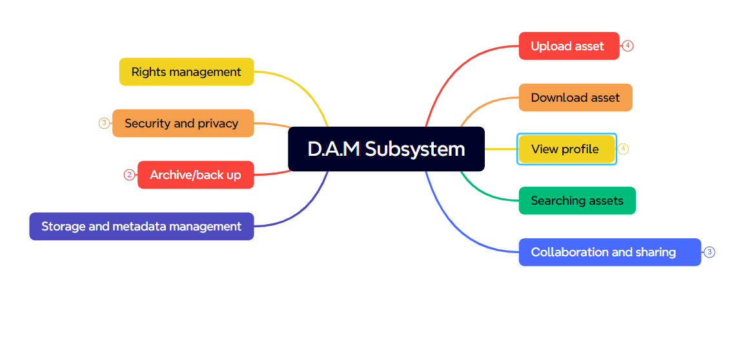
Mind map
DAM Subsystem

Slide 6
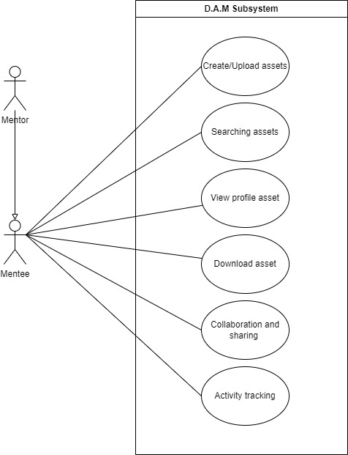
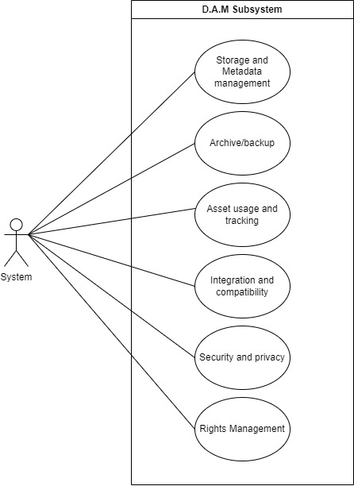
Use-case

Slide 7
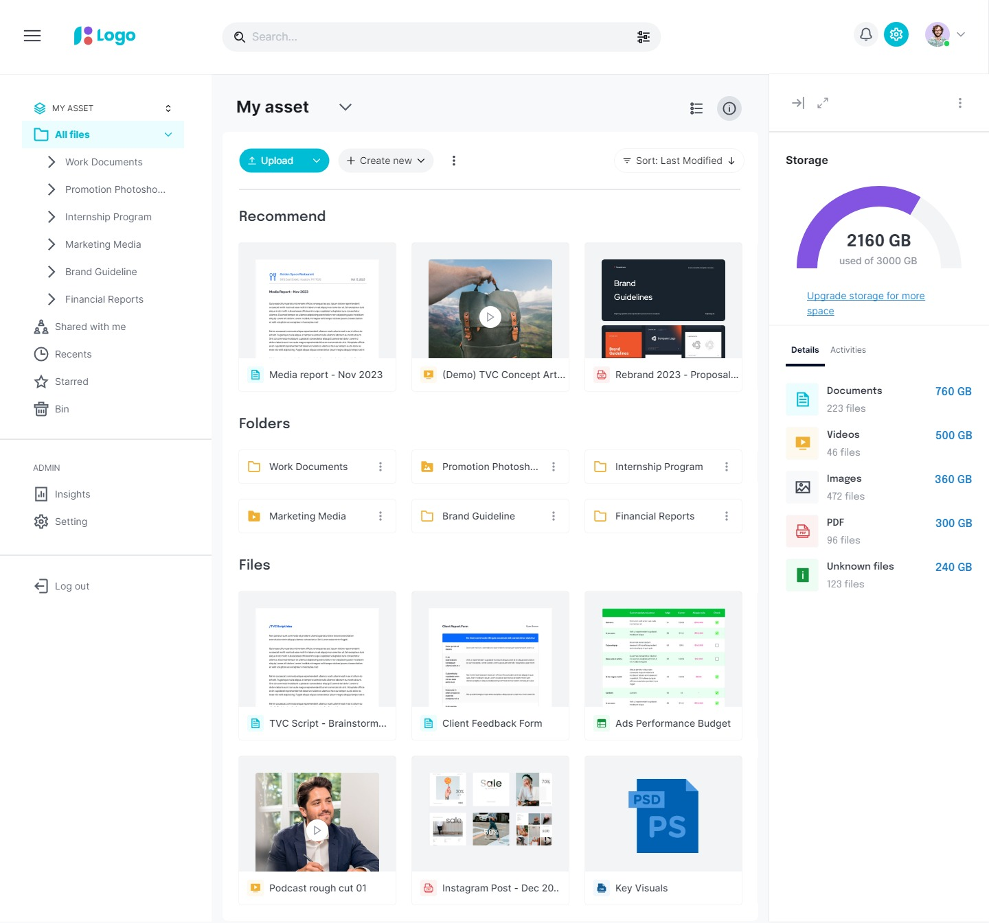
Home page

Slide 8
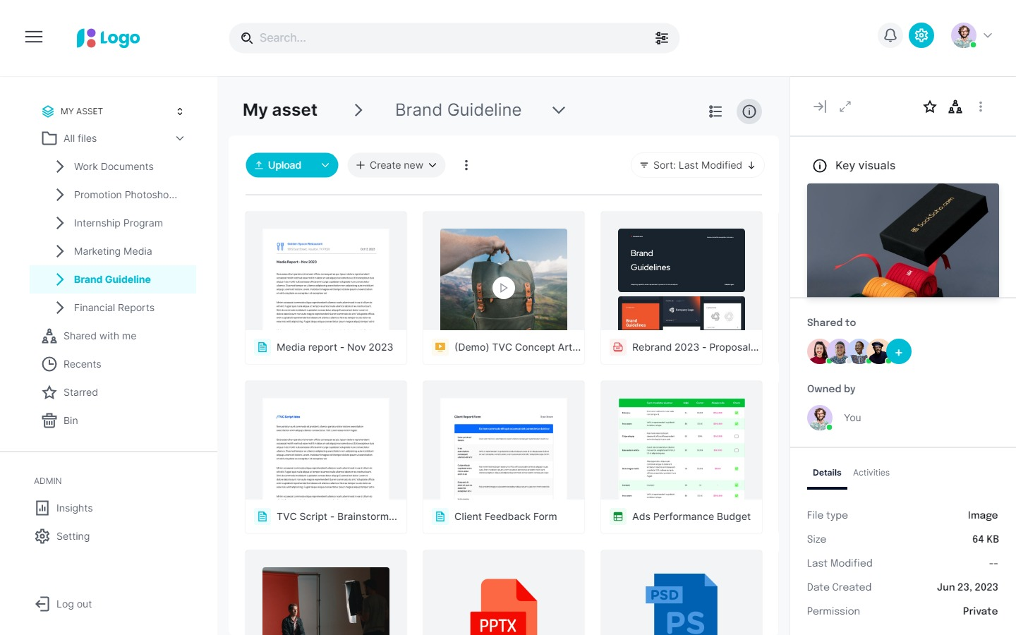
Home page – Grid view

Slide 9
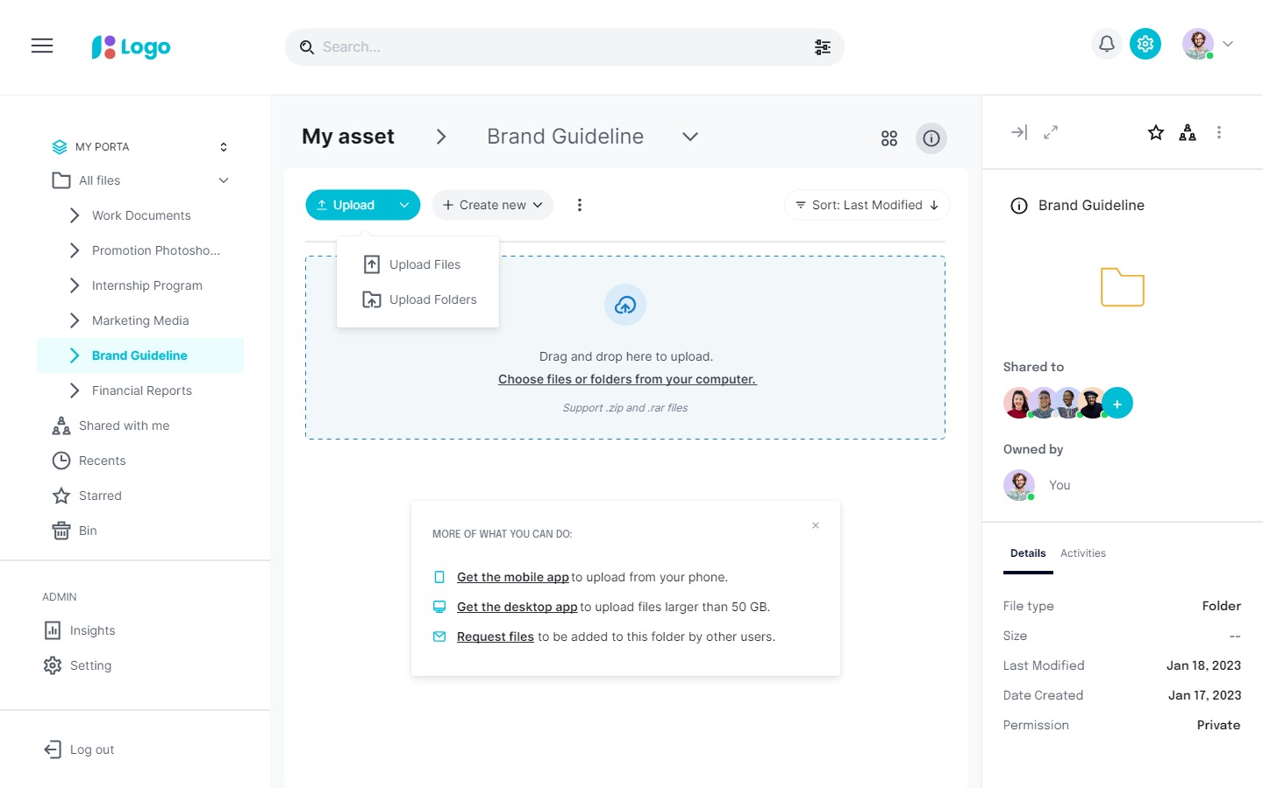
Upload file

Slide 10
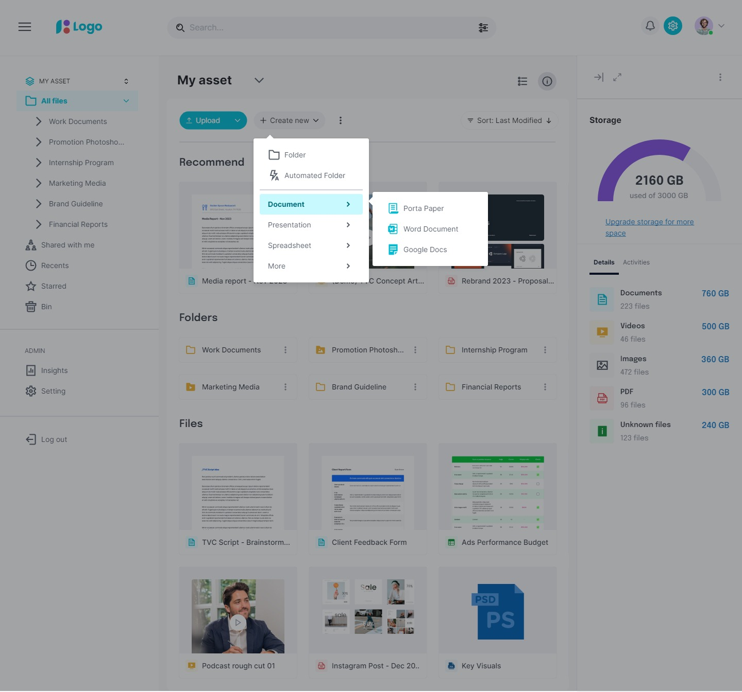
Create new

Slide 11
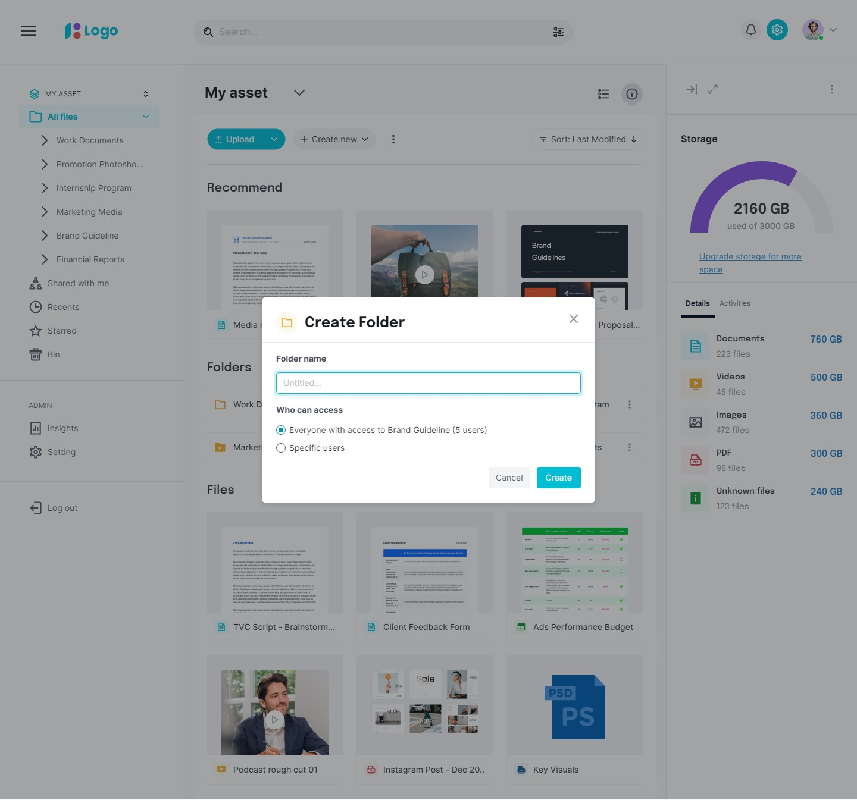
Create folder

Slide 12
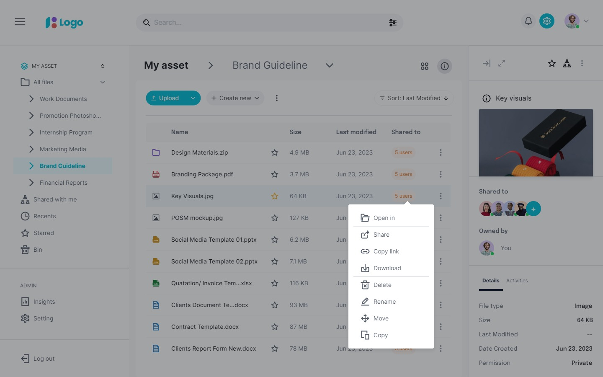
Home page- pop up

Slide 13
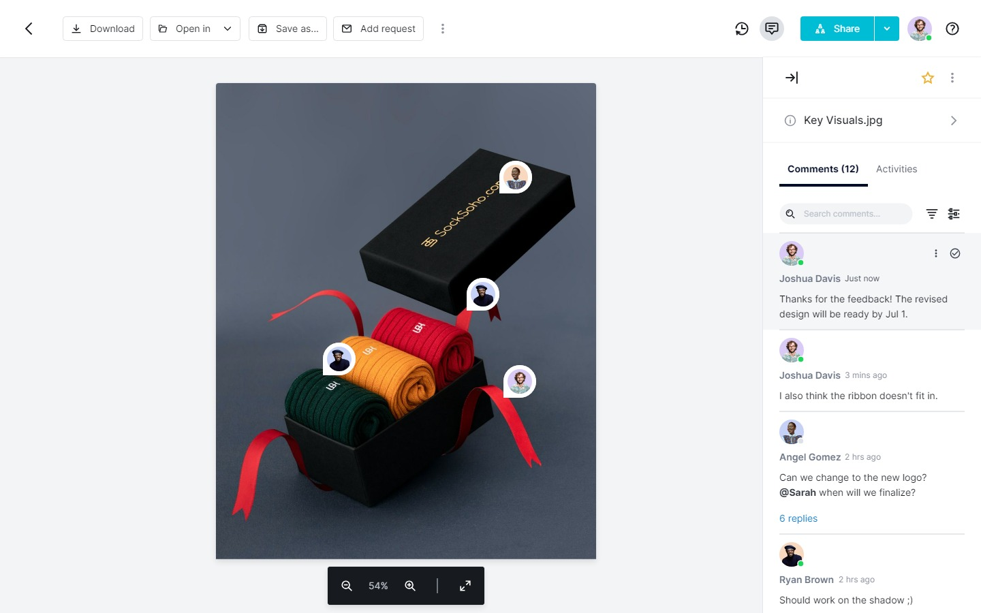
File detail - image

Slide 14
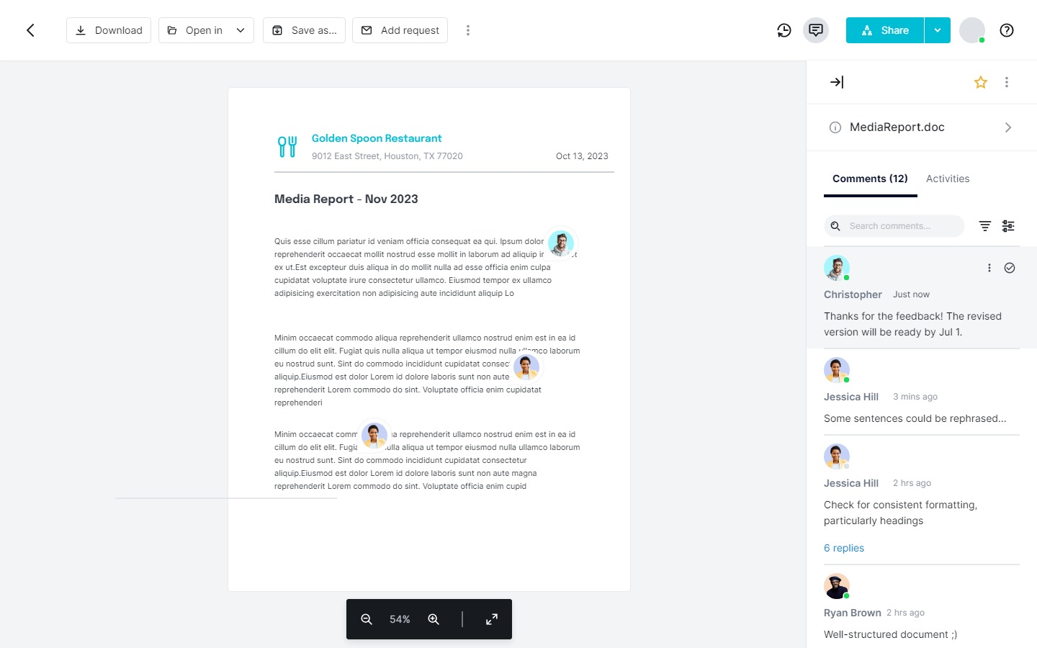
File detail - docs

Slide 15
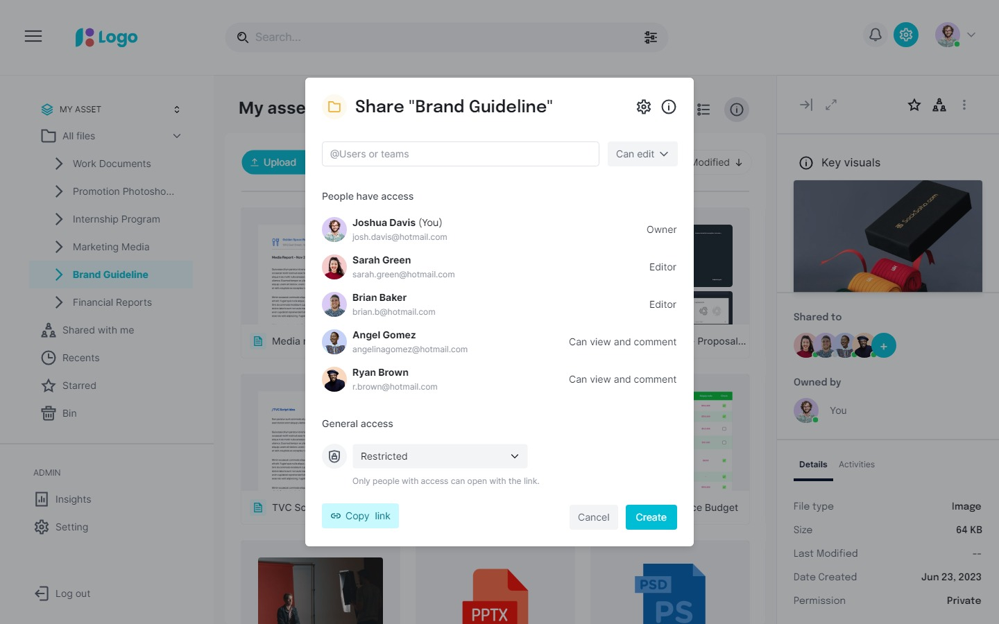
Share a folder

Slide 16
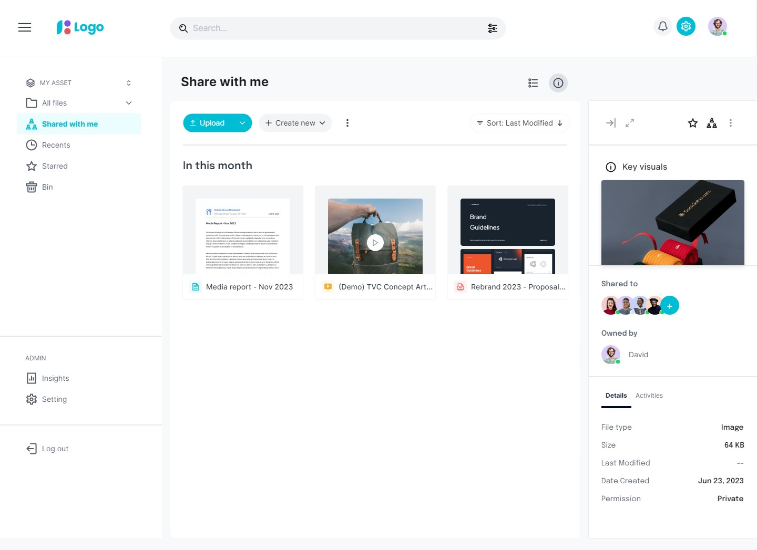
Share with me

Slide 17
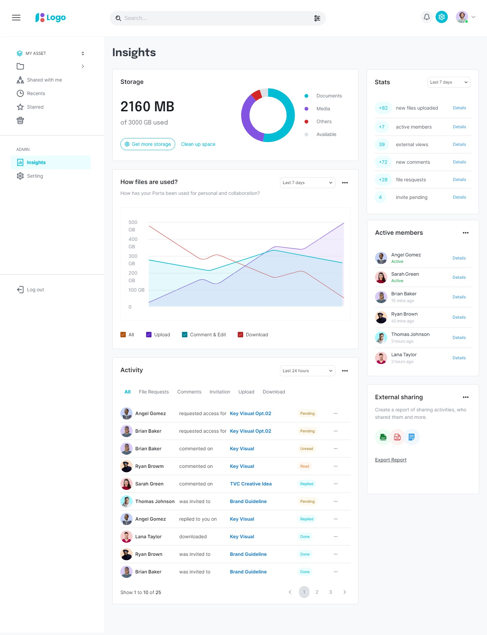
Usage dashboard

Slide 18
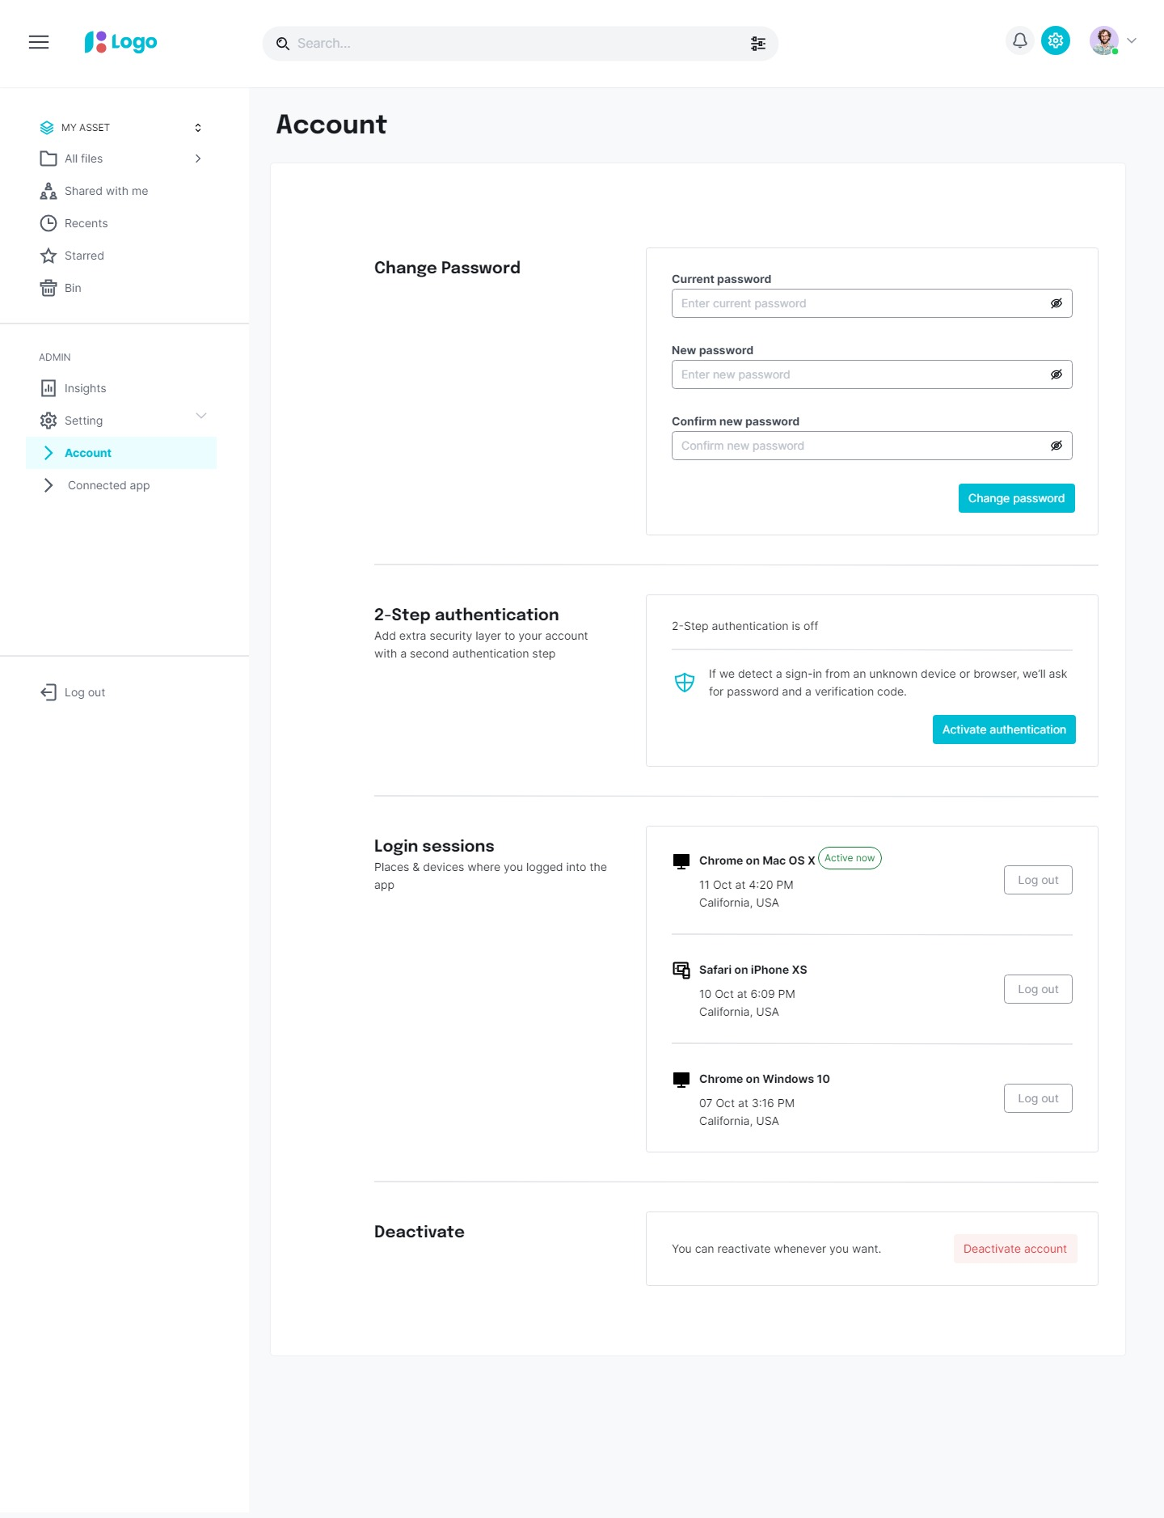
Account setting

Slide 19
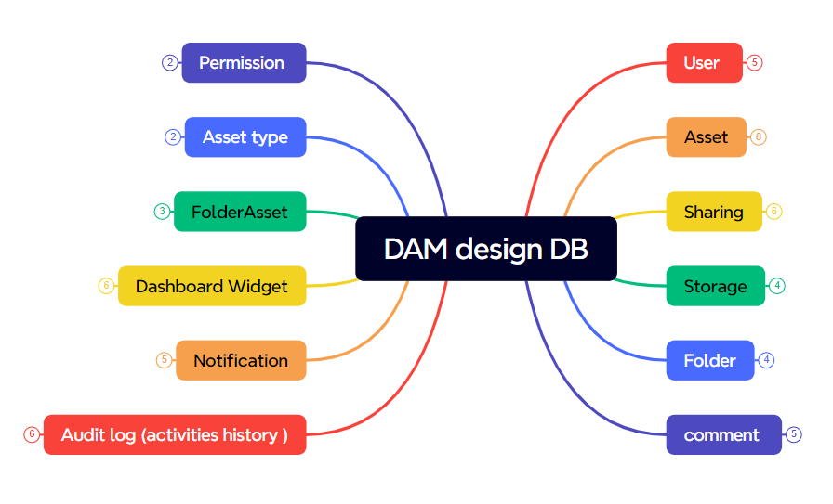
Design DB

Slide 20
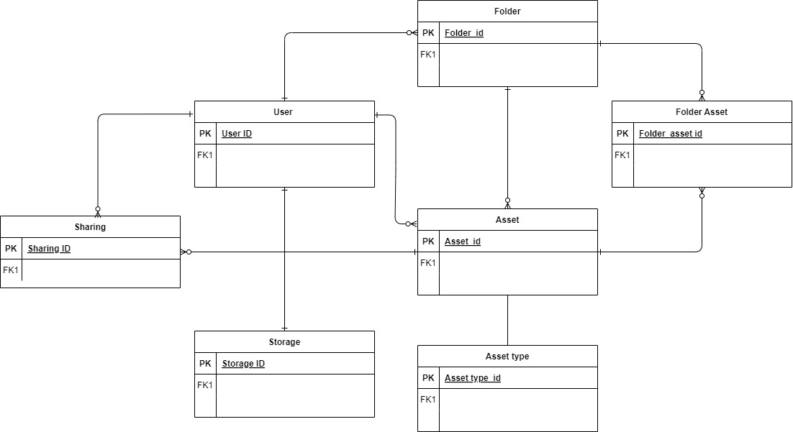
Design DB Home Page

Slide 21
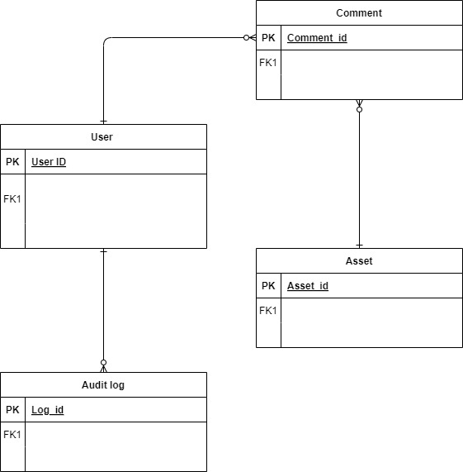
Design DB File Detail

Slide 22
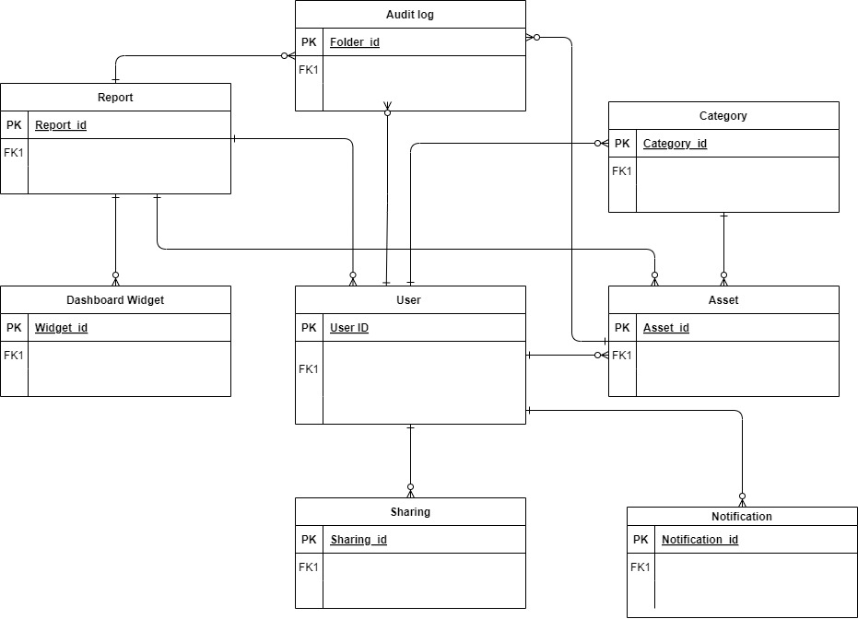
DB design dashboard

Slide 23
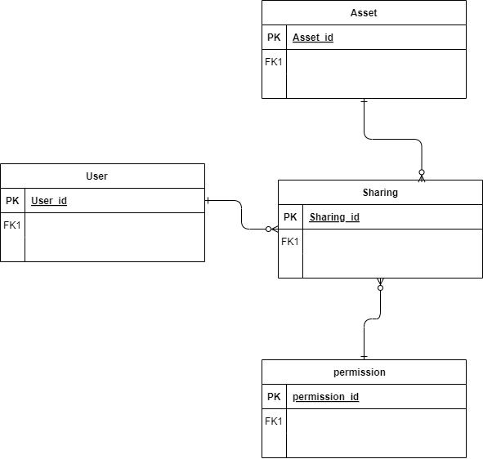
DB design Sharing

Slide 24

DO YOU HAVE ANY QUESTIONS FOR ME ?

